Slide 1


MIS 531 Project
Developing a Data Management System for Enhancing Olympic Games Experience
Notes:
Speaker - Rishab

Slide 2







AGENDA
01
Problem Statement, Solution
02
Conceptual Design
03
Logical and Physical Design
04
Sample queries and Procedures
05
Front End Demo
Notes:
Speaker - Rishab

Slide 3
PROBLEM STATEMENT
There’s a myriad of data ranging from athlete performance, event scheduling, venue management, to viewership statistics that needs to be meticulously organized, analyzed, and utilized.
The current challenge is the lack of a unified, efficient, easily accessible system leading to inefficiencies in decision-making, operational delays, and a suboptimal experience for athletes, organizers, and spectators.
By addressing this problem through our project, we will be contributing to a more efficient, enjoyable, and data-driven Olympic Games, benefiting all stakeholders involved from athletes to global audiences.
Notes:
Speaker - Rishab

Slide 4

SOLUTION: OLYMBIZZ of data ranging
Problem Statement
Enhanced Decision Making
Efficient Venue Management
Improved Athlete Performance Tracking
Targeted Marketing and Sponsorship Opportunities
By integrating various data points organizers can make informed decisions, leading to smoother event management and enhanced contingency planning.
The system will provide a detailed analysis of athlete performances which can be used for strategic planning and performance enhancement.
With data on venue managers can optimize space usage, enhance security protocols, and ensure the safety and comfort of attendees.
helps in designing targeted marketing campaigns and attracting potential sponsors, thereby increasing revenue streams.
Notes:
Speaker - Rishab

Slide 5
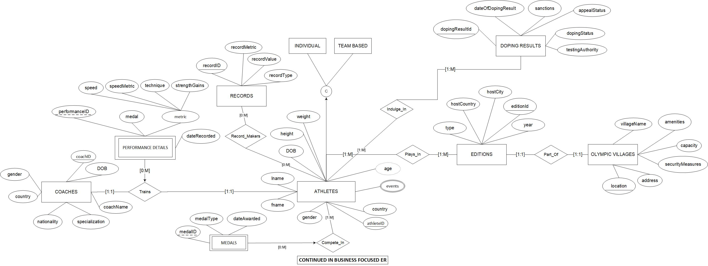
ER DIAGRAM – ATHLETES FOCUSSED
Notes:
Speaker - Rishab

Slide 6
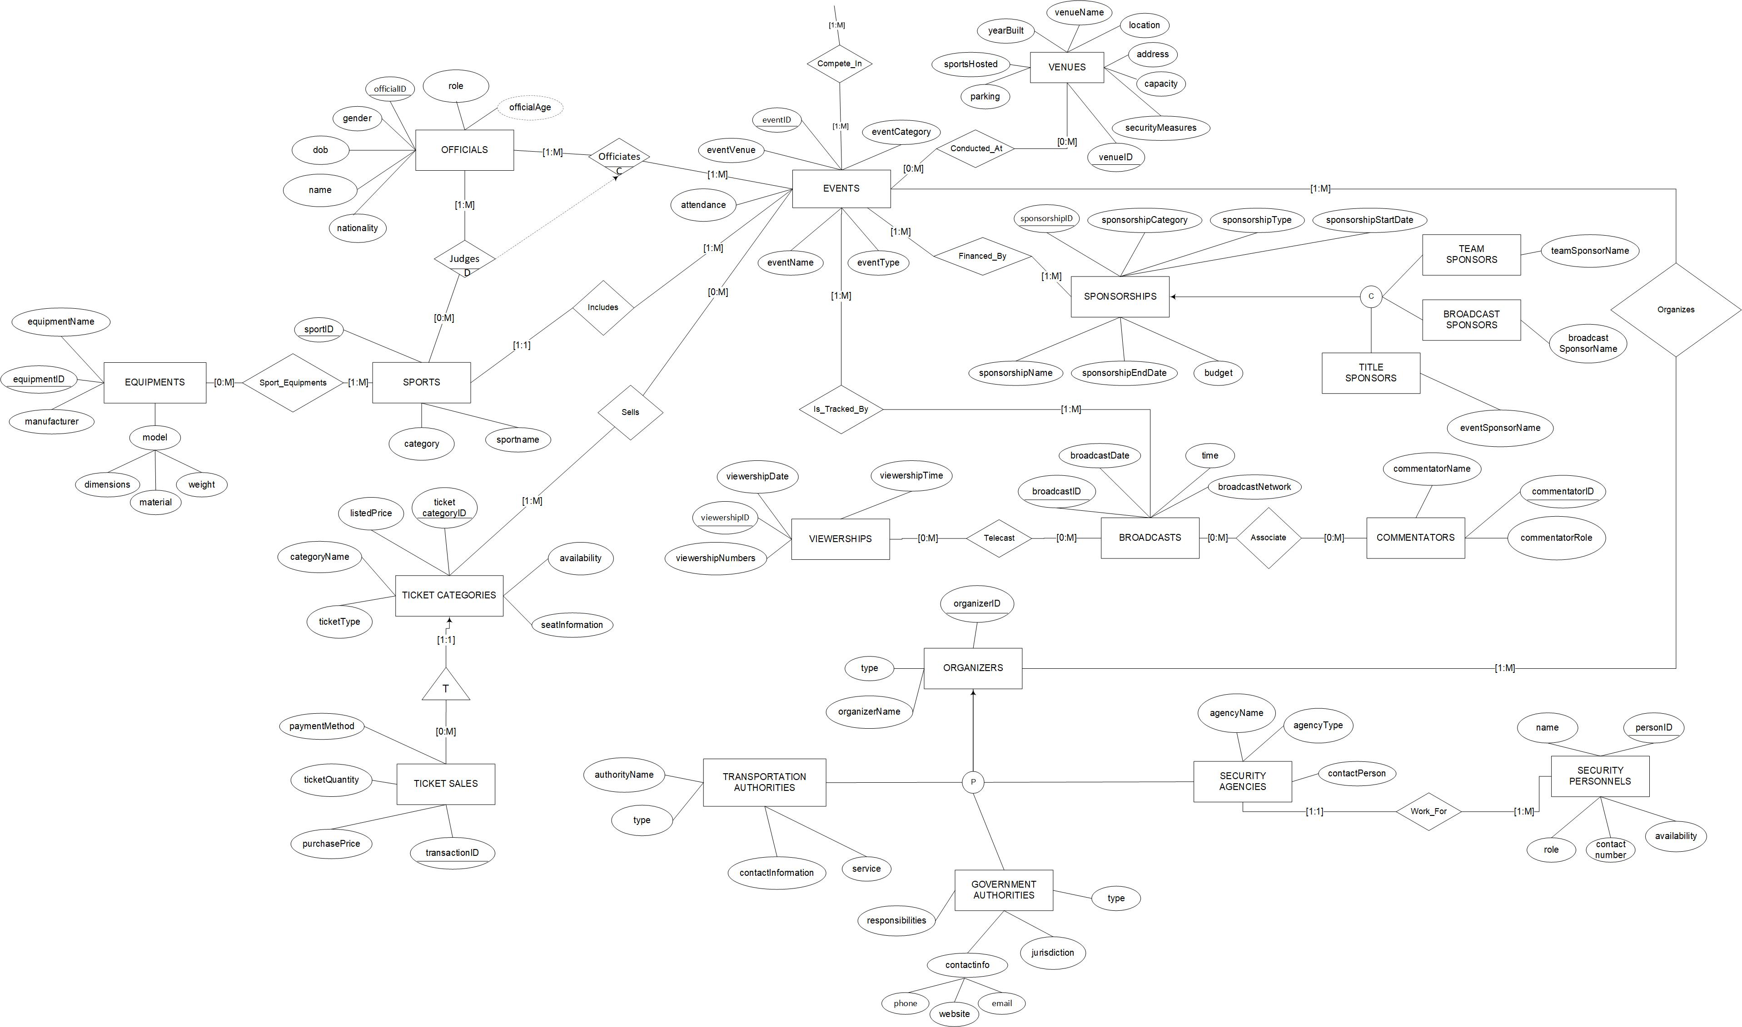
ER DIAGRAM – BUSINESS FOCUSSED
Notes:
Speaker - Siddharth

Slide 7
ER TO RELATIONAL DESIGN
ATHLETES(athleteId, country, gender, Fname, Lname, DOB, height, weight)
COACH(coachID, coach_name, gender, country, nationality, specialization, DOB)
PERFORMANCE_DETAILS(performanceID, athleteID, coachID, medal, daterecorded, speed, technique, strength_gains)
Foreign key (athleteID) references ATHLETES
Foreign key (coachID) references COACHES
ATHLETE_RECORDS(athleteId, recordID)
Foreign key (athleteID) references ATHLETES
Foreign key (recordID) references RECORDS
EVENTS(eventID, sportID, eventVenue, attendance, eventName, eventType, eventCategory) Foreign key (sportID) references SPORTS
TICKET_CATEGORY(ticketcategoryID, listedPrice, categoryName, ticketType, availability, seatInformation)
TICKET_SALE(transactionID, ticketcategoryID, purchasePrice, ticketQuantity, paymentMethod) Foreign Key (ticketcategoryID) references TICKET_CATEGORY
Time period: July 2021 to October 2021
Notes:
Speaker – Rishab

Slide 8
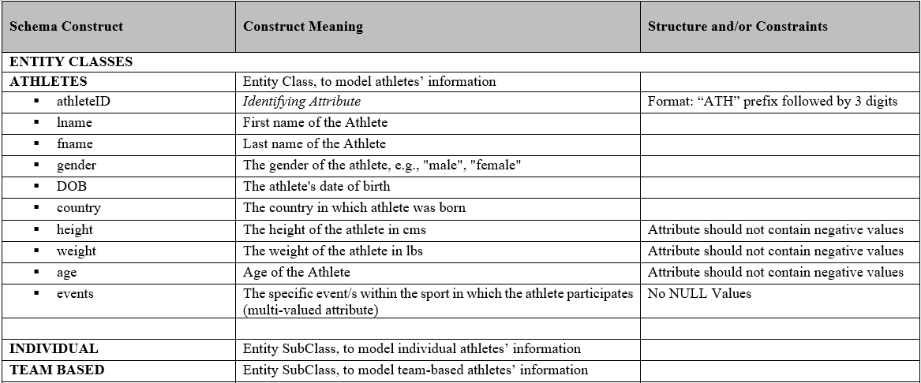
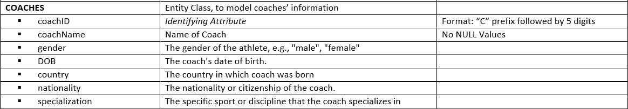
TABLE DESIGN
Time period: July 2021 to October 2021
Notes:
Speaker – Rishab

Slide 9
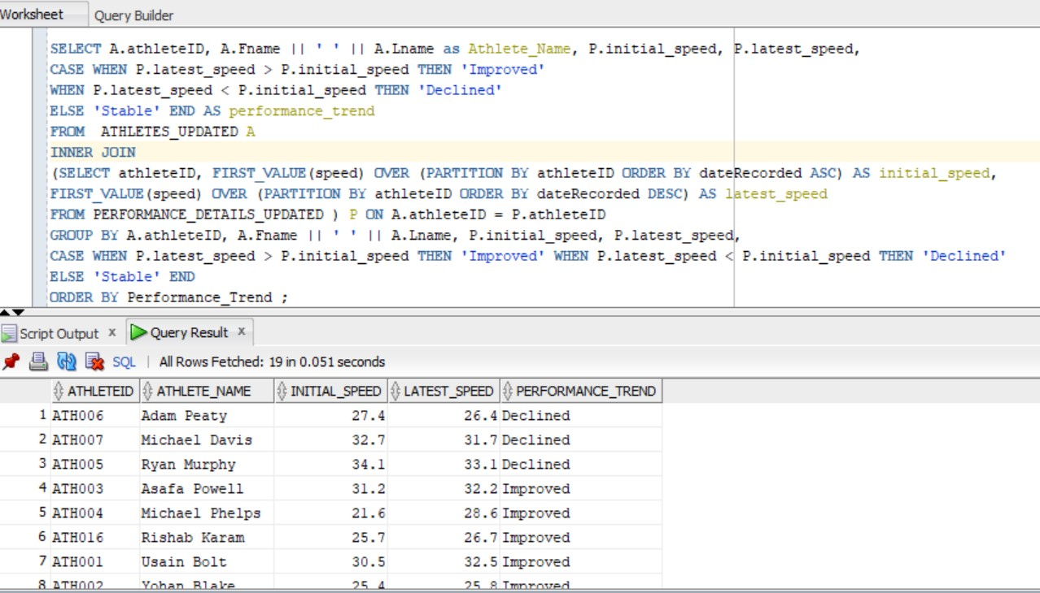
SQL CODE 1
Analyzes athletes’ improvement trends by comparing initial and latest speeds and retrieves athlete ID, name, initial speed, latest speed, and categorizes trends as 'Improved,' 'Declined,' or 'Stable.'
Notes:
Speaker - Simran

Slide 10
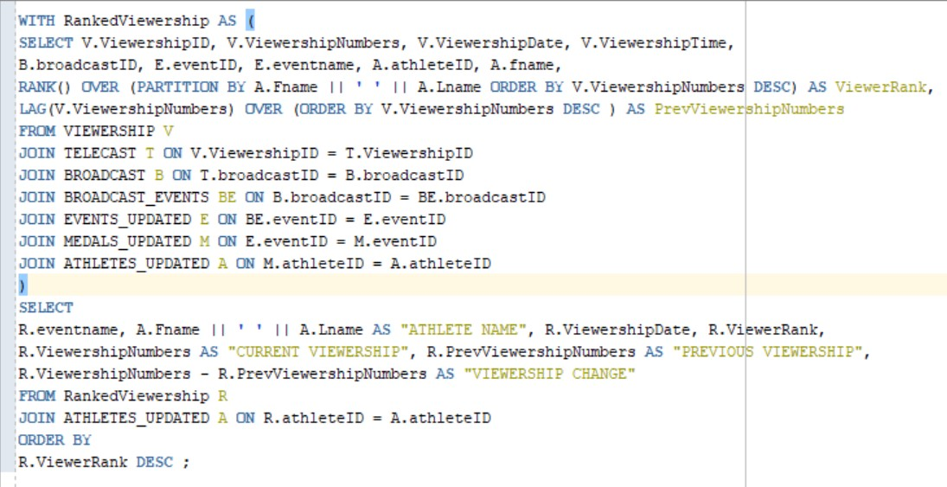
SQL CODE 2
Compiles ranked viewership data for athletes during events from the Olympics dataset. The results offer insights into audience engagement and popularity among athletes across events
Notes:
Speaker - Simran

Slide 11
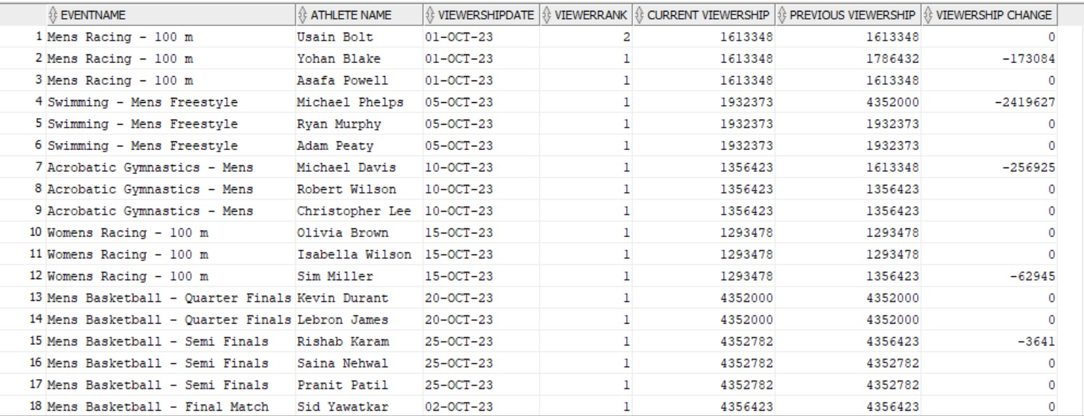
SQL CODE 2
This query compiles ranked viewership data for athletes during events from the Olympics dataset. The results offer insights into audience engagement and popularity among athletes across events
Notes:
Speaker - Simran

Slide 12
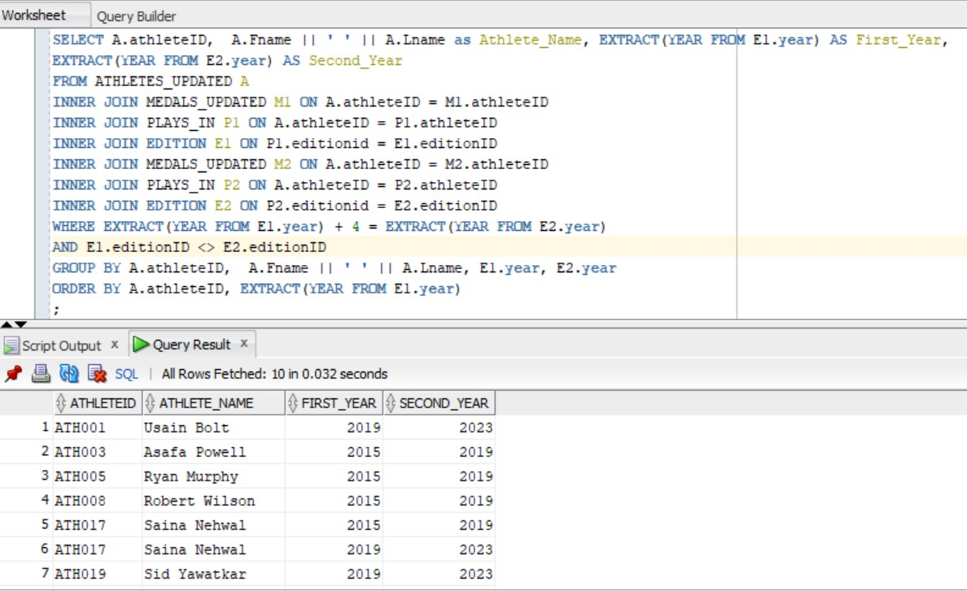
SQL CODE 3
This query identifies athletes who won in consecutive Olympic editions exactly four years apart, and provides insights into athletes' consistent improvement in the Olympics across consecutive quadrennial events
Notes:
Speaker - Isha

Slide 13
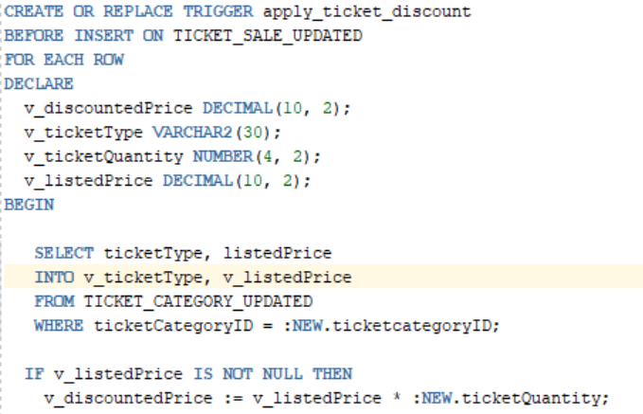
TRIGGER 1
This trigger computes the purchase price for each ticket sale by evaluating the ticket type, quantity purchased, and listed price, and then applies a discount based on the number of tickets bought.
Time period: July 2021 to October 2021
Notes:
Speaker - Isha

Slide 14
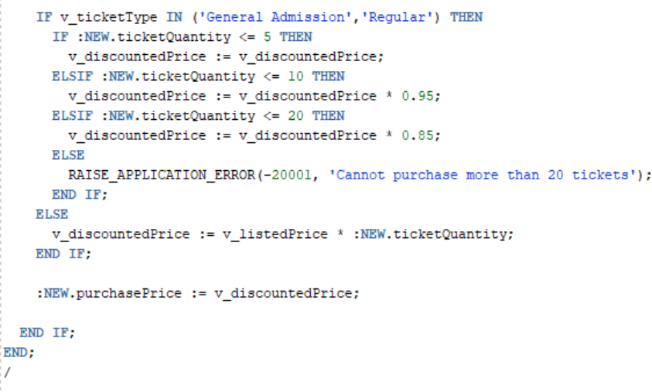
TRIGGER 1
Time period: July 2021 to October 2021
Notes:
Speaker - Isha

Slide 15
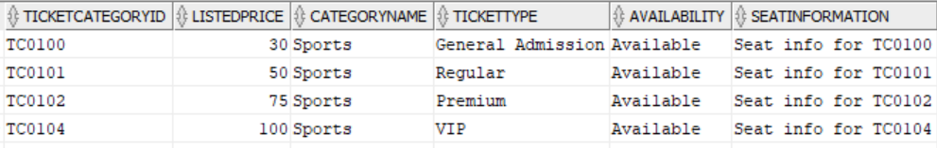
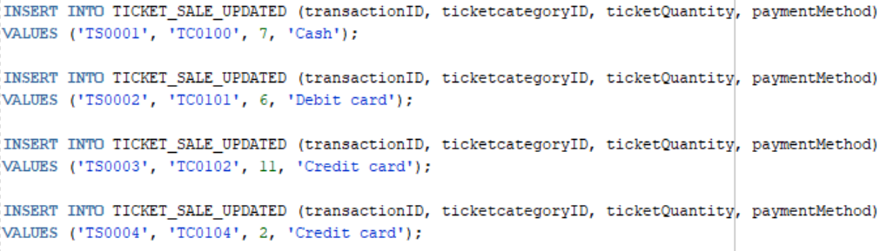
TRIGGER 1
Select * from TICKET_CATEGORY_UPDATED;
Insert Values into TICKET_SALE_UPDATED Table
Time period: July 2021 to October 2021
Notes:
Speaker - Isha

Slide 16
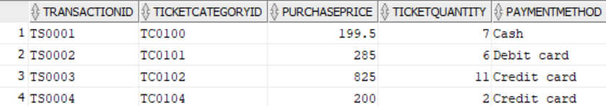
TRIGGER 1 OUTPUT
Select * from TICKET_SALE_UPDATED;
Time period: July 2021 to October 2021
Notes:
Speaker - Isha

Slide 17
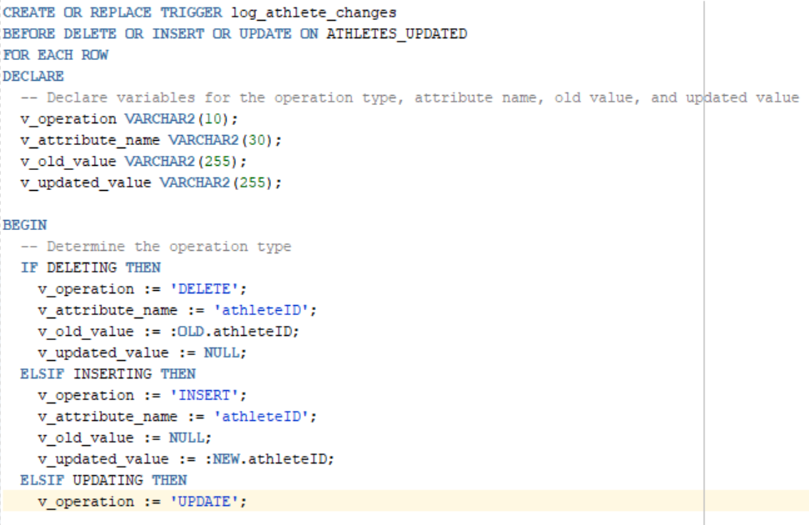
TRIGGER 2
This Trigger is designed to capture changes made to the Athletes table and log them into an Audit trail.
Time period: July 2021 to October 2021
Notes:
Speaker - Ayush

Slide 18
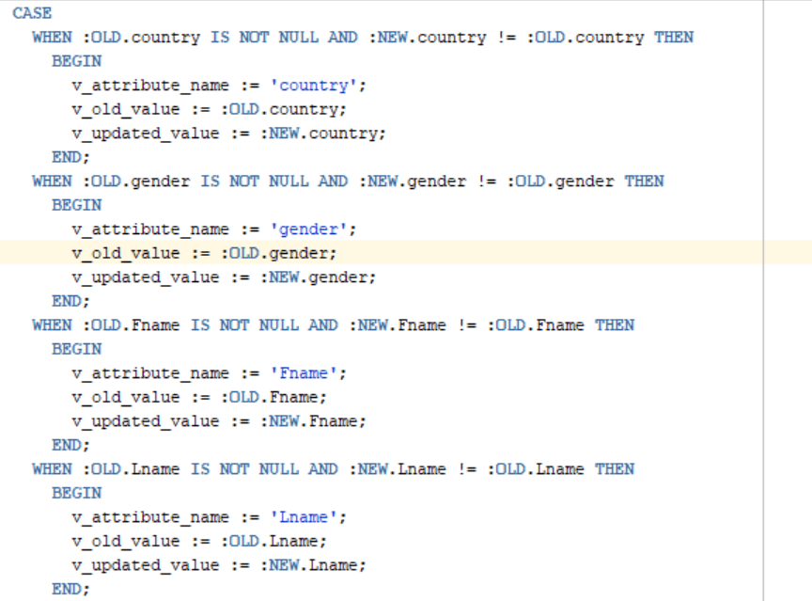
TRIGGER 2
Time period: July 2021 to October 2021
Notes:
Speaker - Ayush

Slide 19
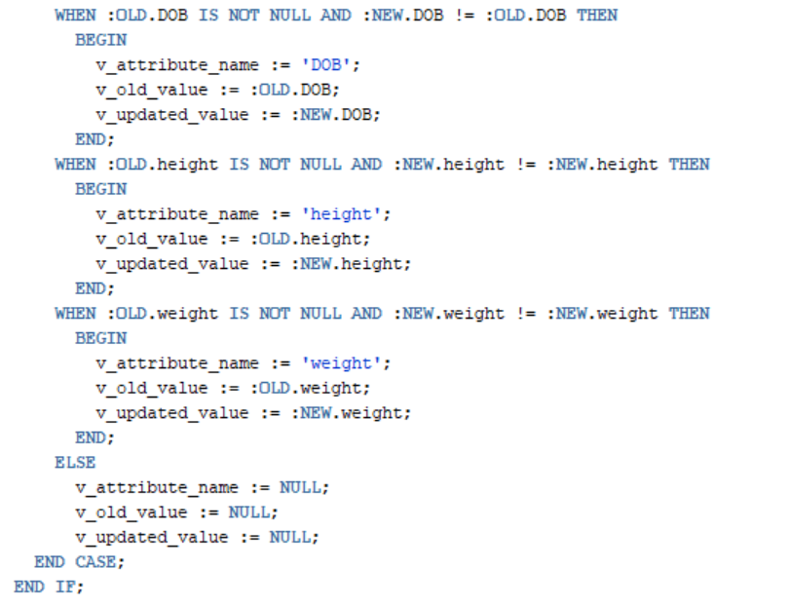
TRIGGER 2
Time period: July 2021 to October 2021
Notes:
Speaker - Ayush

Slide 20
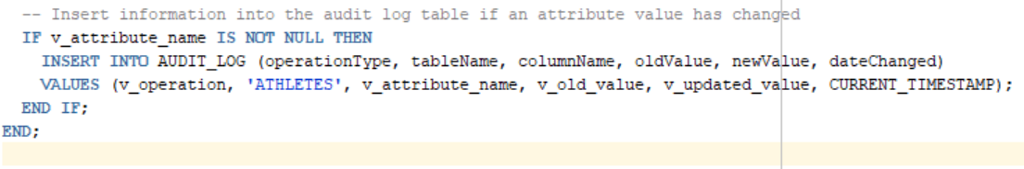
TRIGGER 2
Time period: July 2021 to October 2021
Notes:
Speaker - Ayush

Slide 21
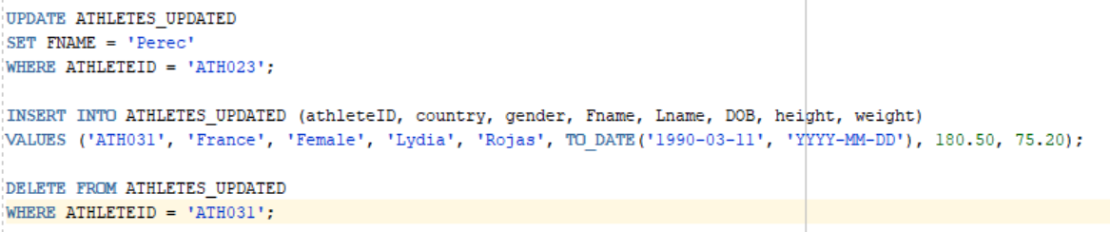
TRIGGER 2 OUTPUT
Updating, Inserting and Deleting Athlete data
AUDIT_LOG TABLE :
Time period: July 2021 to October 2021
Notes:
Speaker - Ayush

Slide 22
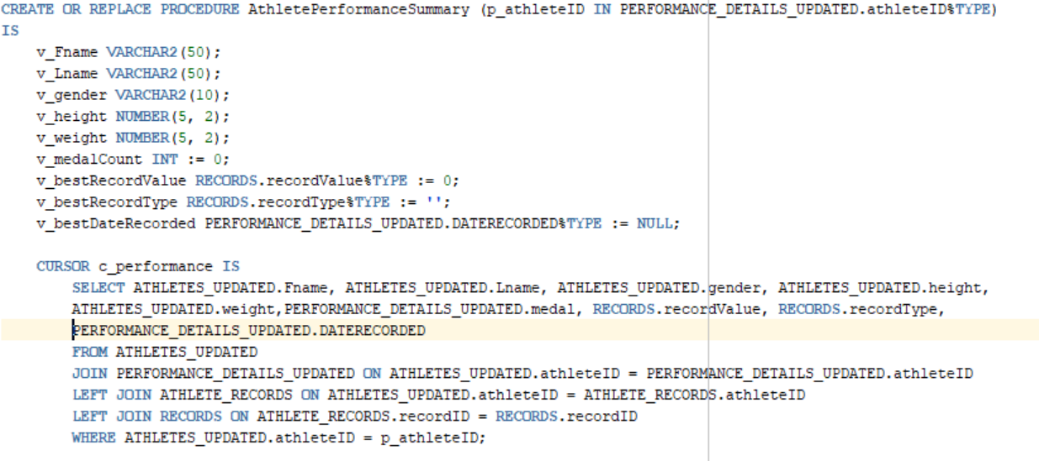
PROCEDURE
This procedure generates an athlete performance summary for a specific athlete based on their records and athlete details.
Time period: July 2021 to October 2021
Notes:
Speaker - Siddharth

Slide 23
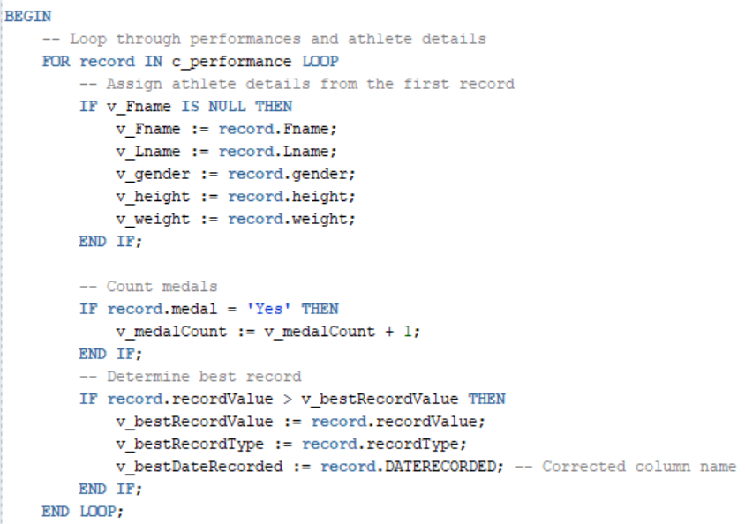
PROCEDURE
Time period: July 2021 to October 2021
Notes:
Speaker - Siddharth

Slide 24
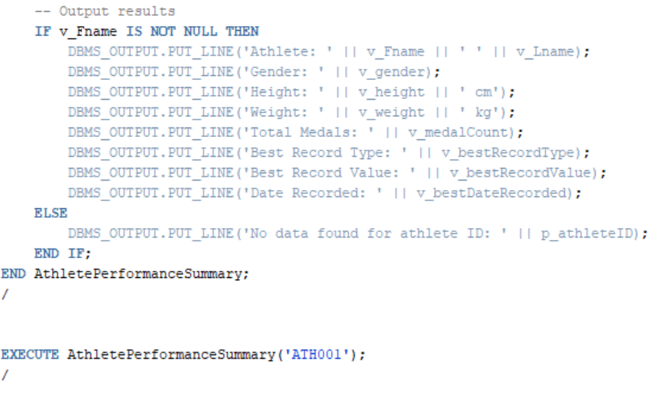
PROCEDURE
Time period: July 2021 to October 2021
Notes:
Speaker - Siddharth

Slide 25
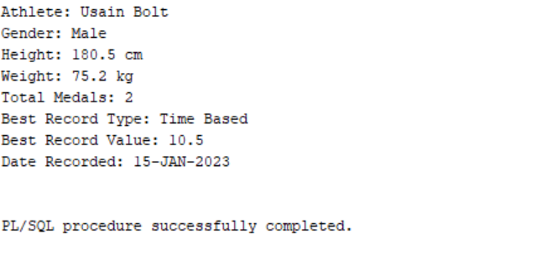
PROCEDURE OUTPUT
Time period: July 2021 to October 2021
Notes:
Speaker - Siddharth

Slide 26
Thank You
Notes:
Speaker - Siddharth

